Slide 1


Łukasz Nakonieczny
08.11.2022

Slide 2

Outline
Executive Summary
Introduction
Methodology
Results
Conclusion
Appendix

Slide 3
Executive Summary
Summary of methodologies
We will use webscraping, API and SQL queries to obtain needed data.
Working within Python data ecosystem we will use Pandas for exploratory data analysis (EDA) and Matplotlib, Seaborn and Folium for data visualization.
Using Python Dash package, we will prepare dashboard summarizing most important of our findings during EDA stage.
Lastly, we will train and deploy machine learning model for purpose of judging is first stage retrieval will be successful or not.
Summary of all results
For payload of the mass up to 8000 kg any launch site will do. For heavier payload we must chose between KSC LC 39A and CCAFS SLC 40.
Overall, most successful site is KSC LC 39A.
Two most successful booster versions were B1049 and B1051.
We found out that for our purpose the most suited machine learning classification model is based on the Decision Tree algorithm and achieved 94% accuracy.

Slide 4
Introduction
Project background and context
Since commercial space race already begin, we intend to take part in it and claim as large part of the market as its is possible. We will analyze publicly available SpaceX data concerning Falcon 9 launches to gain insights on the first stage retrieval probability. We hope that this allows as to develop competitive pricing strategy.
Problems you want to find answers
What is optimal choice of launch parameters including landing site choice and booster characteristics. The purpose is to minimize launch cost by maximizing probability of first stage retrieval.

Slide 5

Section 1

Slide 6
Methodology
Executive Summary
Data collection methodology:
use of the SpaceX API and webscraping on Falcon 9 launches Wikipedia website
Perform data wrangling
unnecessary data were removed from dataset and missing values were treated
features needed for further explorations were added
Perform exploratory data analysis (EDA) using visualization and SQL
Perform interactive visual analytics using Folium and Plotly Dash
Perform predictive analysis using classification models
most relevant features were chosen and dummy variables for categorical data were introduced
we use set of classifications models on the data to find optimal one for prediction landing outcome
for fine tunning and scoring models we used sklearn library

Slide 7
Data Collection
Describe how data sets were collected.
You need to present your data collection process use key phrases and flowcharts

Slide 8
Data Collection – SpaceX API
We used SpaceX API to obtain json file containing data relevant for previous rocket launches (for purpose of further analysis we used snapshot of data provided by IBM)
We queried additional endpoint of API to obtain data about booster version, launch site name, payload mass, outcome of the landing and detail of the landing process
We filtered data to contains only entries related to Falcon 9 rocket model
We replaced missing values in the payload mass column by the mean of the payload mass
Results were exported to csv file for further use
https://github.com/LNakonieczny/IBM_Data_Science_Capstone_Project/blob/main/jupyter-labs-spacex-data-collection-api.ipynb
Request and parse launch data using get request
Filter data to contain only Falcon 9 entries
Deal with missing values
Export results to csv

Slide 9
Data Collection - Scraping
We used GET request to obtain additional data for Falcon 9 launches from Wikipedia website (for purpose of further analysis we used snapshot of this data provided by IBM)
We used BeautifulSoup to parse obtained HTML response object
We created pandas dataframe from parsed HTML tables
We exported results to csv file
https://github.com/LNakonieczny/IBM_Data_Science_Capstone_Project/blob/main/jupyter-labs-webscraping.ipynb
Use Request to obtain additional Falcon 9 launch data from Wikipedia website
Parsing HTML tables to create dataframe
Export results to csv

Slide 10
Data Wrangling
Deal with missing values
Create a landing outcome label from Outcome column
Check data types
Create dummy variables to categorical columns
Cast all numeric columns to float64
We checked if all data are of correct type
We replaced missing values in the payload mass column by the mean of the payload mass
We created binary variable ’Class’ that take value 0 when landing of first stage was failure and 1 when landing was successful
Using Pandas get_dummies method we transformed categorical variables to the numerical ones
We casted all numeric columns to float64
https://github.com/LNakonieczny/IBM_Data_Science_Capstone_Project/blob/main/labs-jupyter-spacex-Data%20wrangling.ipynb

Slide 11
EDA with Data Visualization
We used catplot and scatterplot for investigating relations among payload mass , flight number, launch site, and orbit type and they connection to the outcome of the landing of the first stage
We used barplot to visualize success rate for various orbits types
We used lineplot to represent change of success rate for all launches over given time period
https://github.com/LNakonieczny/IBM_Data_Science_Capstone_Project/blob/main/jupyter-labs-eda-dataviz.ipynb

Slide 12
EDA with SQL
We used SQL queries to obtain information about:
launch sites,
payload mass,
successful and failure landing dates and booster versions.
https://github.com/LNakonieczny/IBM_Data_Science_Capstone_Project/blob/main/jupyter-labs-eda-sql-coursera_sqllite.ipynb

Slide 13
Build an Interactive Map with Folium
We created and added to folium map following objects:
circles to indicate launch sites position on global map,
markers to indicate if landing of first stage was a success or failure,
lines for measuring distance between launch site and nearest feature like coastline, railroad, highway or city.
https://github.com/LNakonieczny/IBM_Data_Science_Capstone_Project/blob/main/lab_jupyter_launch_site_location.ipynb

Slide 14
Build a Dashboard with Plotly Dash
We used the following interactions and visualization in dashboard:
piechart to represent success rate for given launch site,
scaterplot for visualization of relations between payload mass and success of retrieving first stage,
dropdown list for drill down on success rate for specific launch site,
slider to Focus on specific payload mass range.
https://github.com/LNakonieczny/IBM_Data_Science_Capstone_Project/blob/main/spacex_dash_app.py

Slide 15
Predictive Analysis (Classification)
Standardize features set with StandardScaler
Split data to test and train sets
Train classification models on train set
Assess accuracy of models on test set
As a preparatory steps before training of chosen classification models we used sklearn StandardSacer (on features) and subsequently train_test_split on whole dataset
We trained selected models on train set
To assess accuracy of the models we used test dataset and score method of sklearn
We visualized accuracy of models with barchart and plot of confusion matrix for best performing model
https://github.com/LNakonieczny/IBM_Data_Science_Capstone_Project/blob/main/SpaceX_Machine%20Learning%20Prediction_Part_5.ipynb

Slide 16
Results
Exploratory data analysis results
Interactive analytics demo in screenshots
Predictive analysis results

Slide 17

Section 2

Slide 18
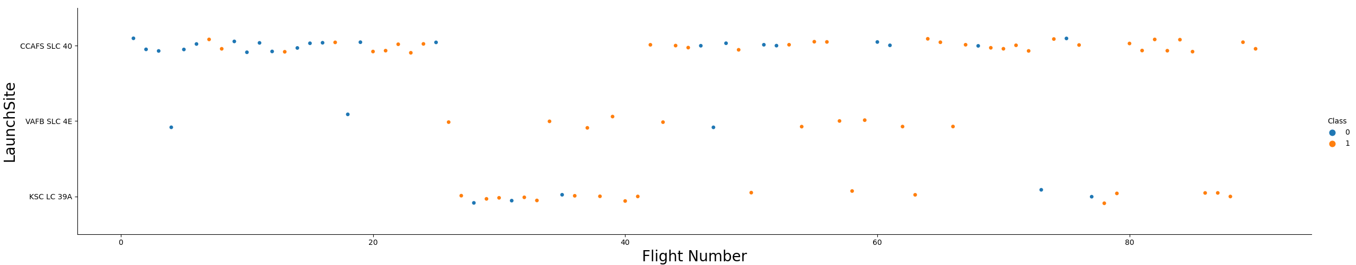
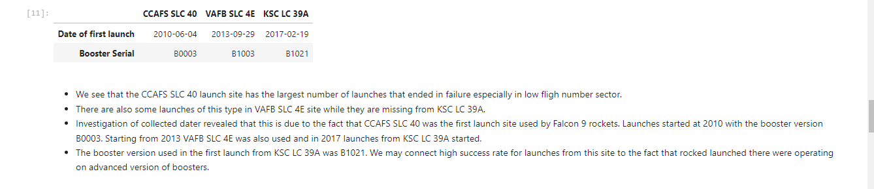
Flight Number vs. Launch Site

Slide 19
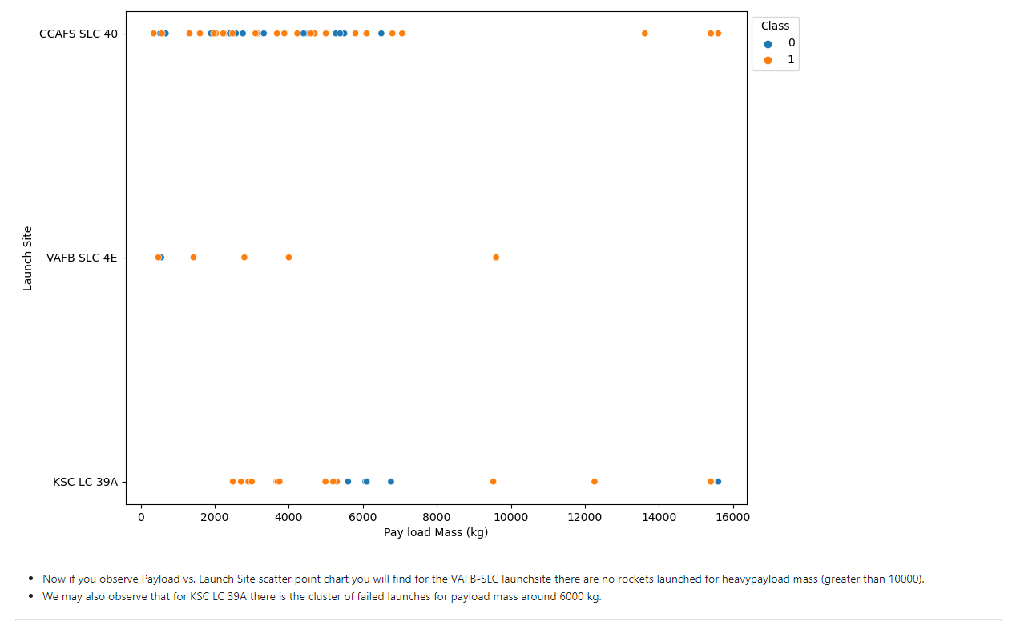
Payload vs. Launch Site

Slide 20
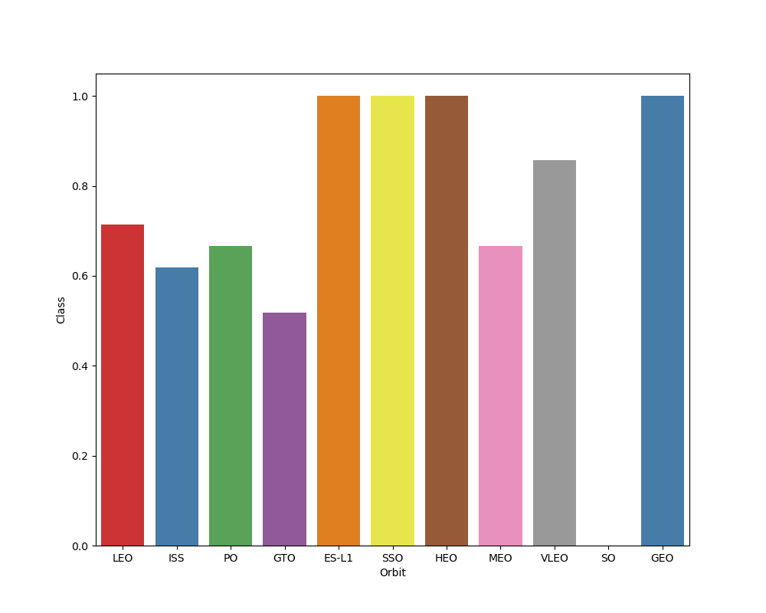
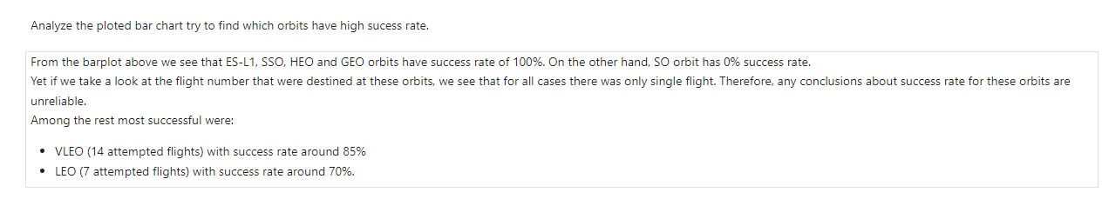
Success Rate vs. Orbit Type

Slide 21
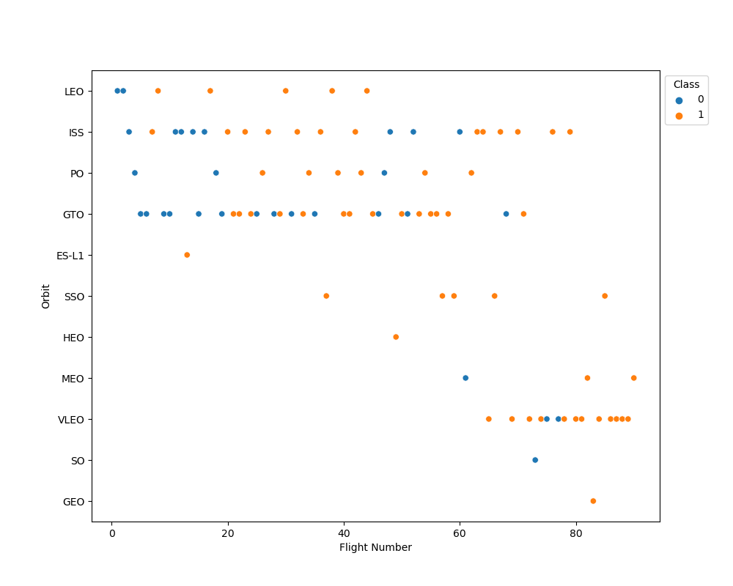
Flight Number vs. Orbit Type

Slide 22
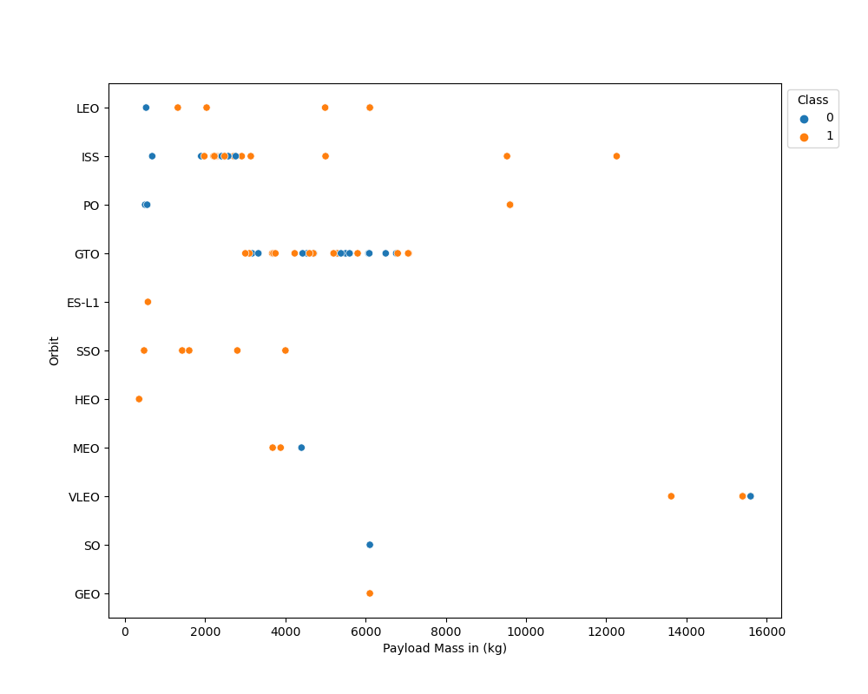
Payload vs. Orbit Type

Slide 23
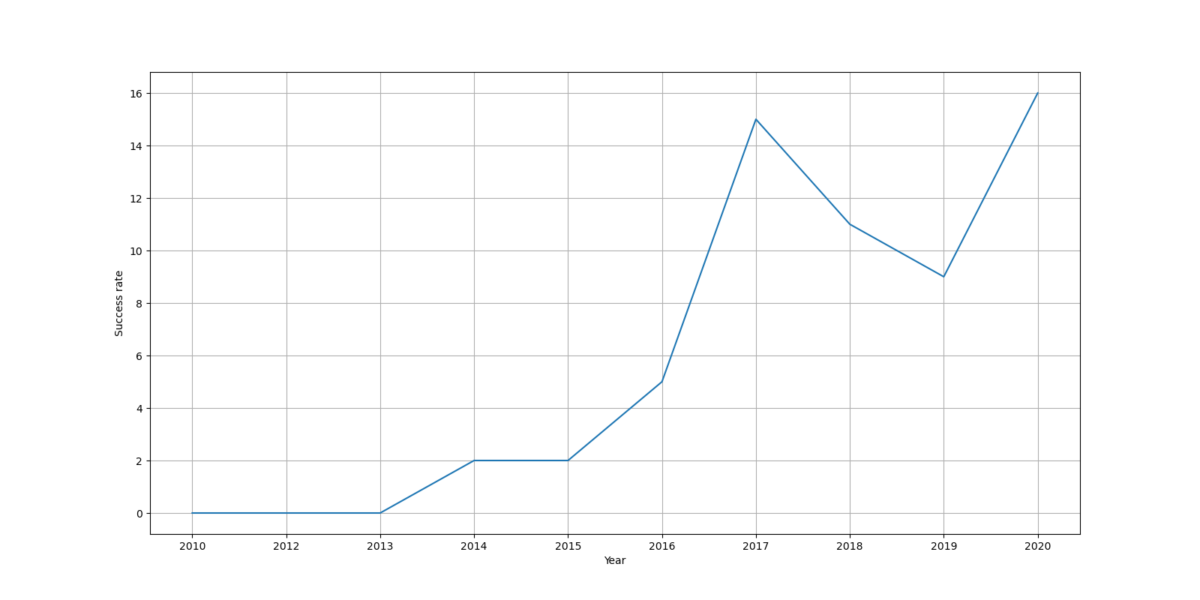
Launch Success Yearly Trend

Slide 24
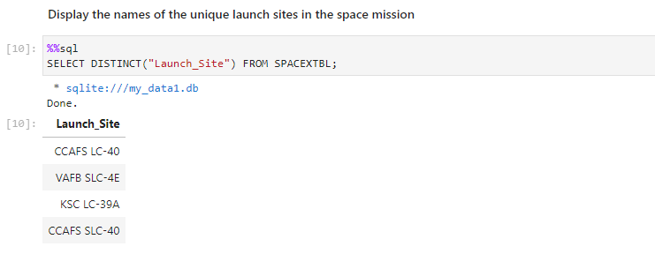
All Launch Site Names
We queried provided sqlite database for unique launch site names.
For this purpose, we used sql magic extension of JupyterLab.

Slide 25
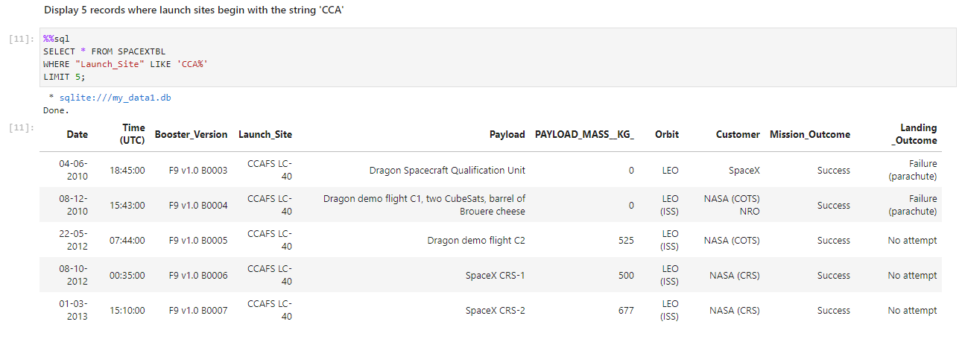
Launch Site Names Begin with 'CCA'
We used WHERE clause with LIKE condition for filter our query.

Slide 26
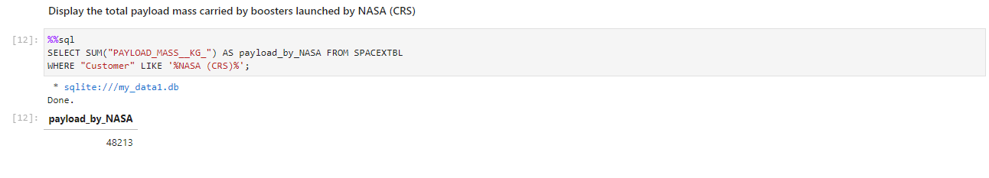
Total Payload Mass
According to our data NASA expedited 48213 kg of payload to various orbits.

Slide 27
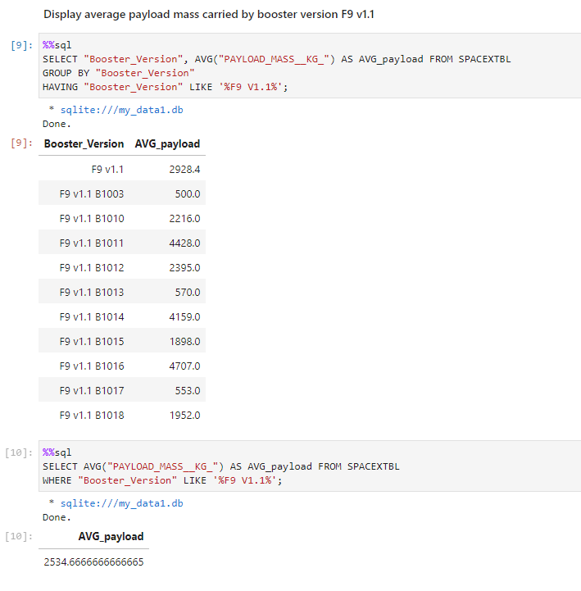
Average Payload Mass by F9 v1.1
Average payload transported by F9 v1.1 is 2534.7 kg.
Using GROUP BY statement with HAVIG clause to calculate average payload carried by various v1.1 booster subversions.

Slide 28
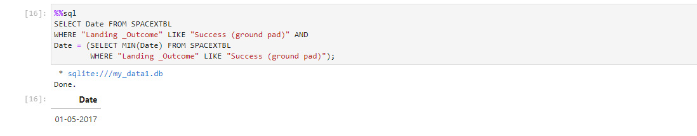
First Successful Ground Landing Date
We used subquery to find that first successful ground pad landing date is 01.05.2017

Slide 29
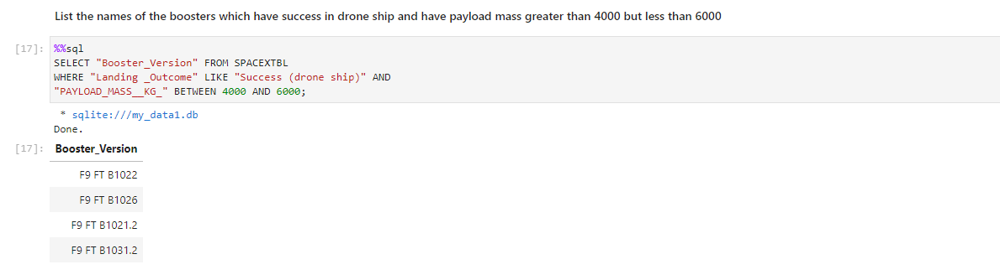
Successful Drone Ship Landing with Payload between 4000 and 6000
We used WHERE clause with BETWEEN condition to find out that there were four booster versions that carried between 4000 and 6000 kg of payload and successfully landed on drone ship.

Slide 30
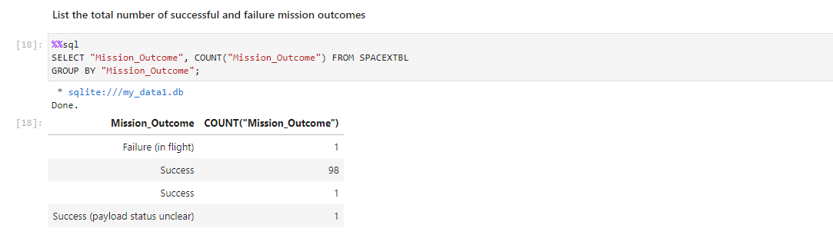
Total Number of Successful and Failure Mission Outcomes
Provided database contains entries for 101 mission outcomes for which 100 ended in success and 1 in failure. To find this we used GROUP BY statement and COUNT aggregate function.

Slide 31
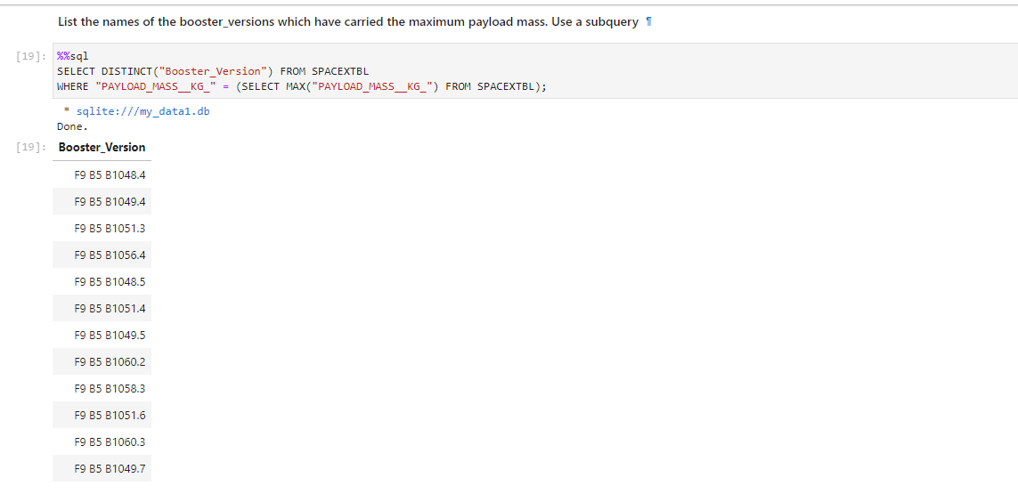
Boosters Carried Maximum Payload
Using subquery, we found out that boosters that carried maximum payload belonged to B5 family.

Slide 32
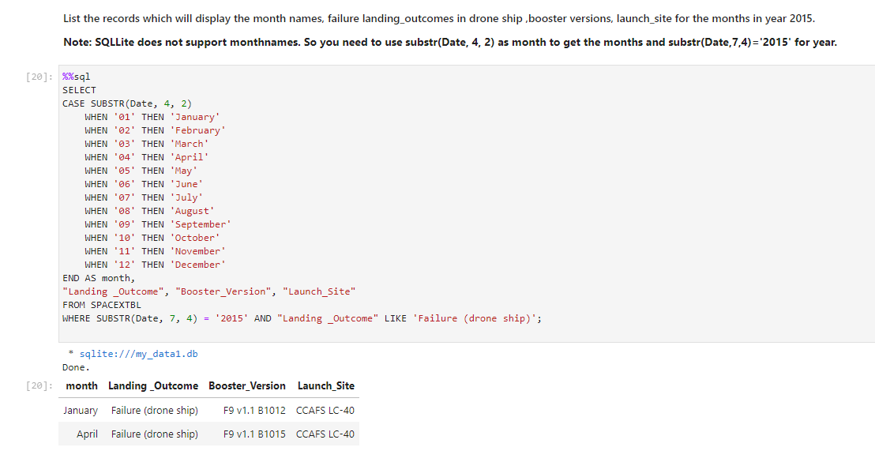
2015 Launch Records
We found out two entries for failed drone ship landings. On technical side we used CASE statement to translate month number to name.

Slide 33
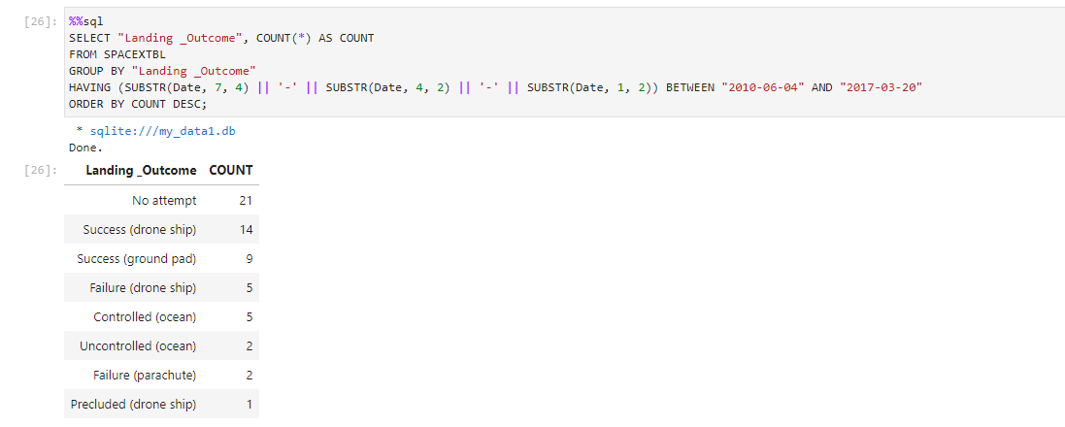
Rank Landing Outcomes Between 2010-06-04 and 2017-03-20
We done this the hard way in sqlite where dates are given in string format and year is last in sequence.

Slide 34

Section 3

Slide 35
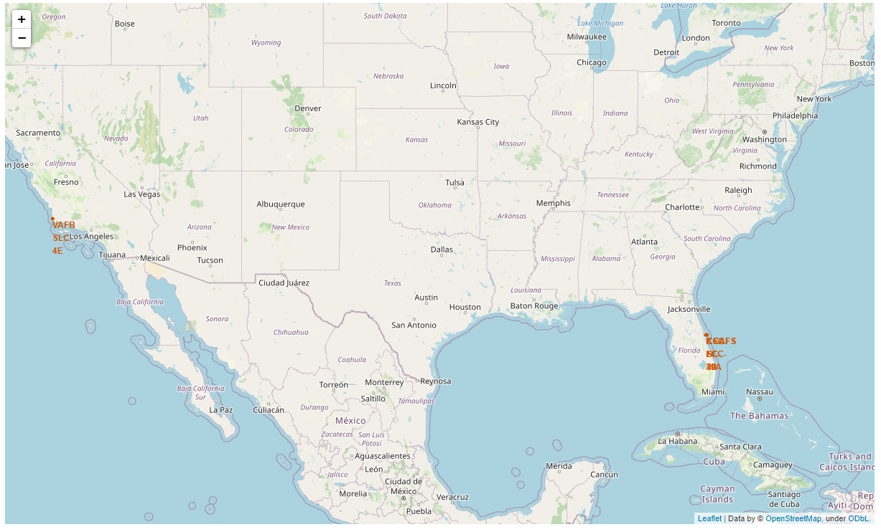
Location of the SpaceX launch sites
We observe that all launch sites are in vicinity of coastline and in relative distance from large urban areas.

Slide 36
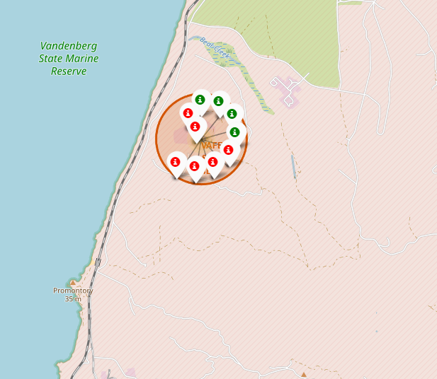
Launch outcome for VAFB SLC 4E base
We used markers to indicate launch outcome.
Green ones represent successful landing of the first stage and the red failed attempt.

Slide 37
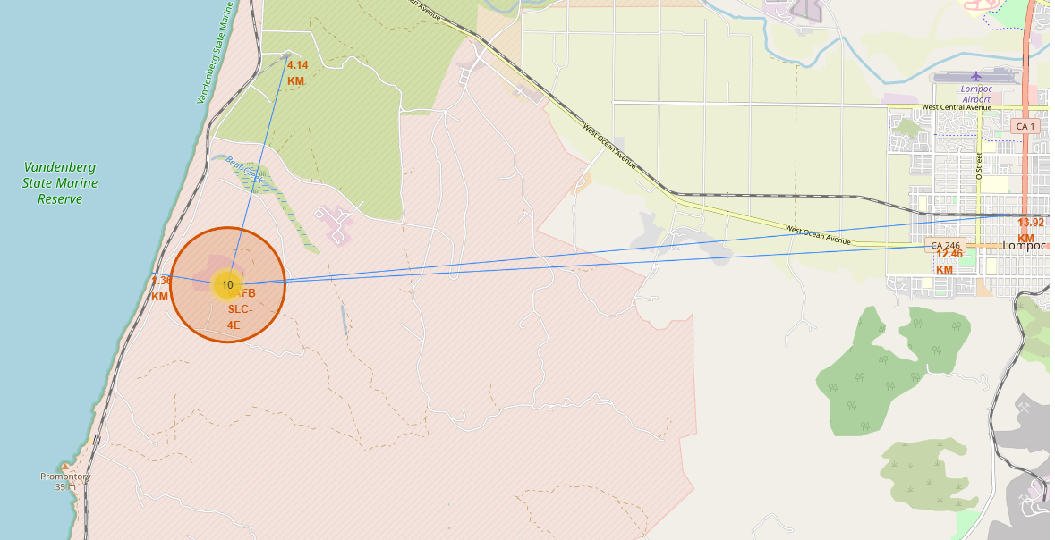
Launch site surrounding landscape and infrastructure

Slide 38

Section 4

Slide 39
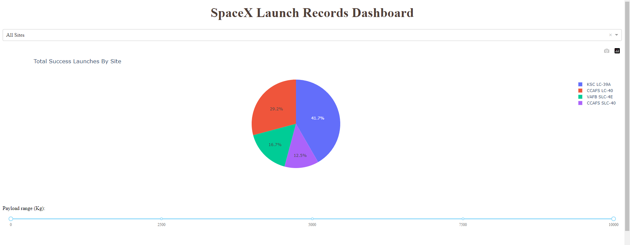
Percentage of successful launches for all sites
Most successful site is KSC LC-39A followed by CCAFS LC-40.
Remaining site have success rate belove 20%.

Slide 40
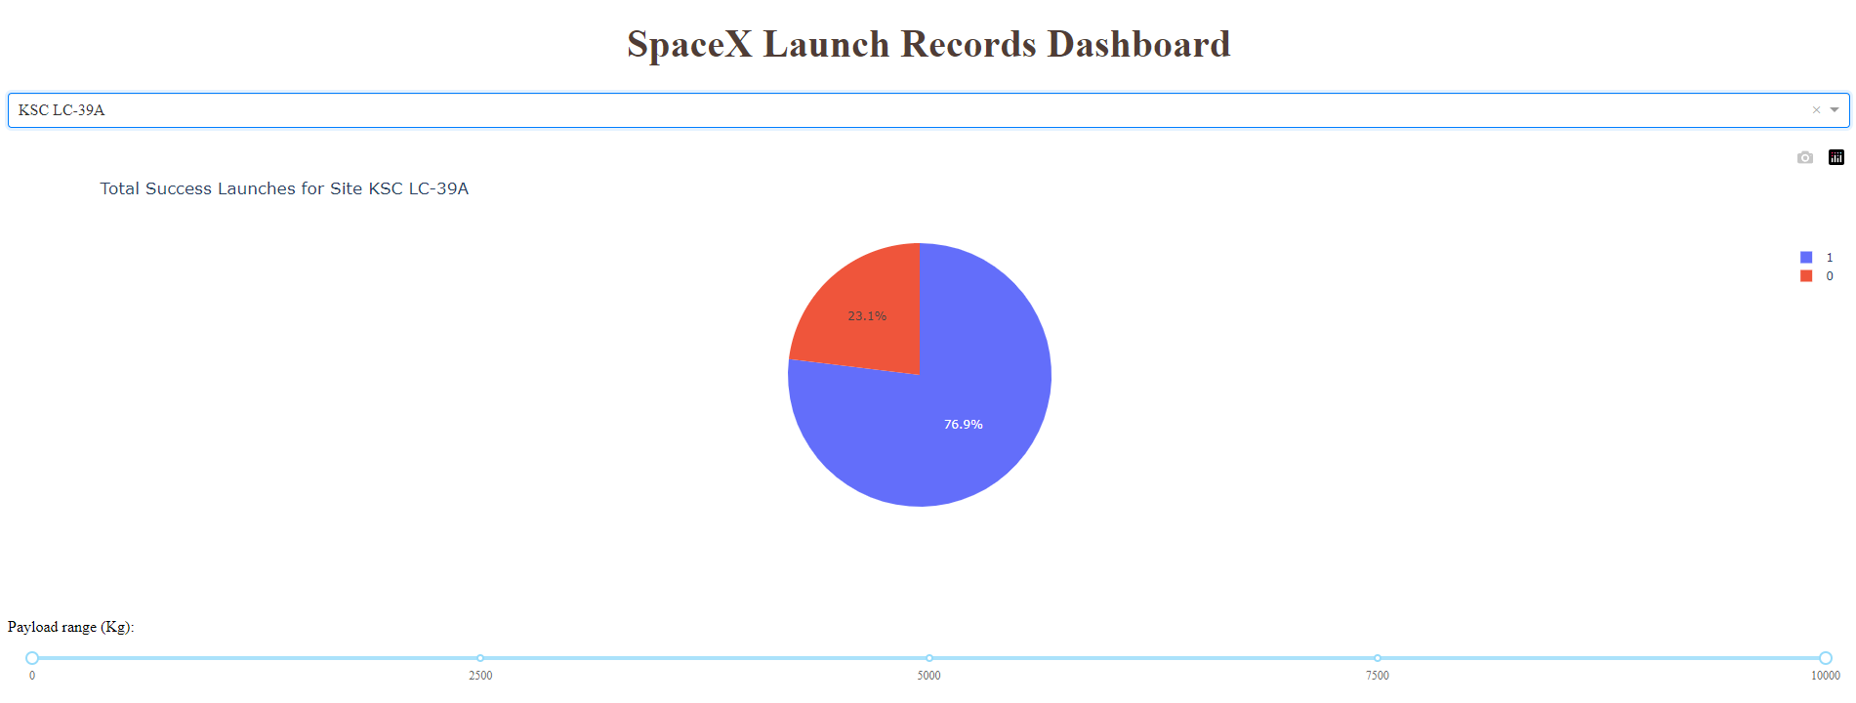
First stage landing statistic for KSC LC-39A site
For this site first stage was successfully landed for almost 77% of cases.

Slide 41
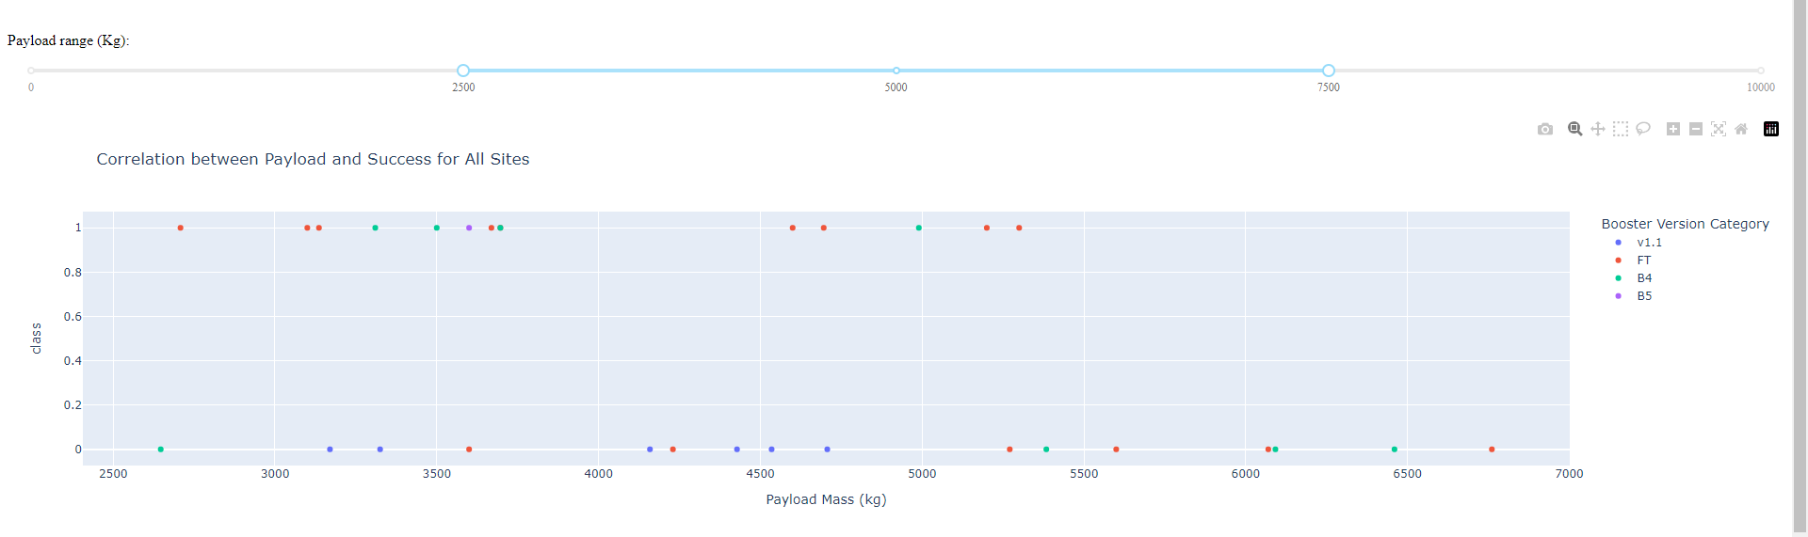
Payload vs Launch Outcome for All Sites
We see that for payload mass range between 2500 and 7500 kg most successful was FT booster.
Worst preforming booster was model v1.1 which was earliest booster introduced.

Slide 42

Section 5

Slide 43
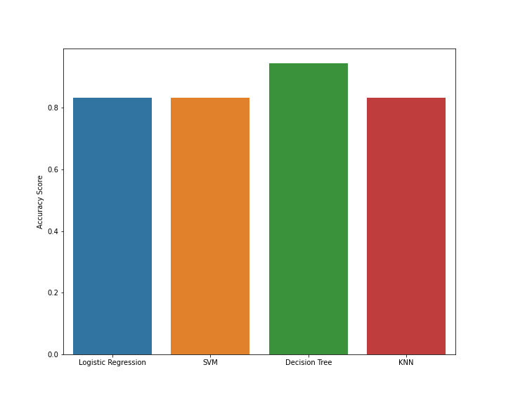
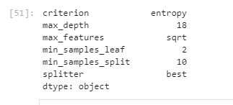
Classification Accuracy
Best classification model was Decision Tree
Best hyperparameters were:
Accuracy calculated by scikit-learn score method was 94%

Slide 44
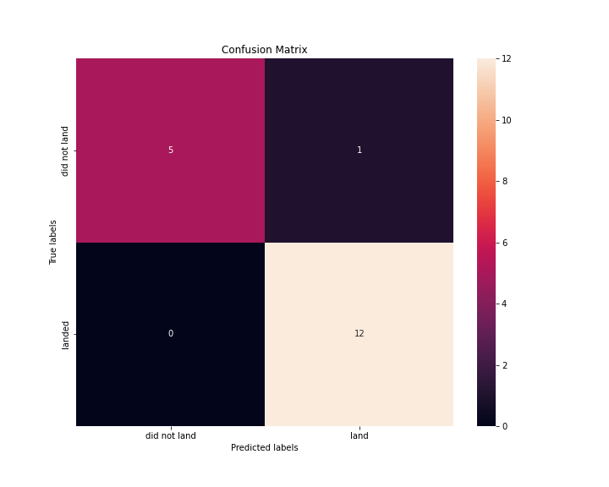
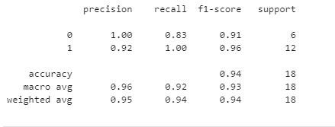
Confusion Matrix
We present confusion matrix for Decision Tree classifier for test dataset:
no. of false positives is 1
no. of false negatives is 0
Classification report containing information in precision and recall:

Slide 45
Conclusions
Collected data indicates that overall, most successful site is KSC LC 39A.
If using it is not possible or cost effective, we may pick alternative based on the payload mass:
for mass up to around 8000 kg any of remaining site will do,
for payload above 8000 kg second to best will be CCAFS SLC 40.
Two most successful booster versions were B1049 and B1051 so it is worth to take as close look at they characteristics as it is possible.
For judging on success on the first stage retrieval for given launch parameters we choose machine learning model based on Decision Tree classifier which achieved 94% accuracy rate on predictions.

Slide 46
Appendix
Include any relevant assets like Python code snippets, SQL queries, charts, Notebook outputs, or data sets that you may have created during this project

Slide 47
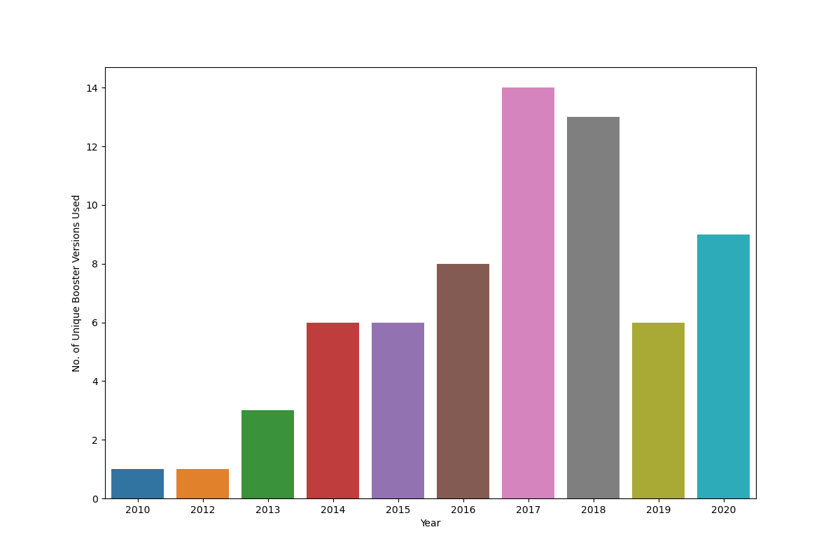
Appendix: unique booster versions used per year

Slide 48
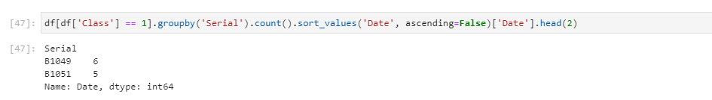
Appendix: most successful booster version

Slide 49
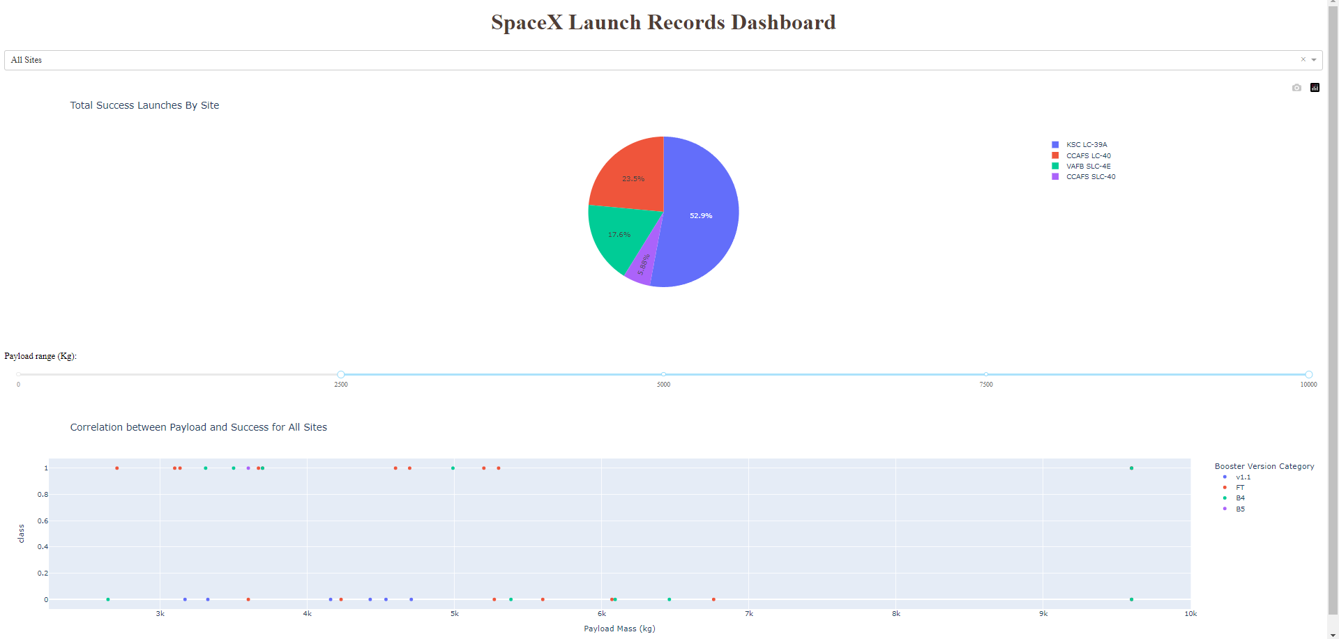
Appendix: SpaceX dashboard for specific payload range

Slide 50
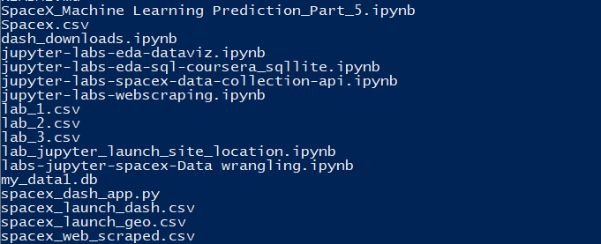
Appendix: list of GitHub archive files
Link for GitHub repo: https://github.com/LNakonieczny/IBM_Data_Science_Capstone_Project
List of files used and created during project preparation:

Slide 51


